Slide 1
A Faster Implementation of Lock Free Hash Set
Danny Balter

Slide 2
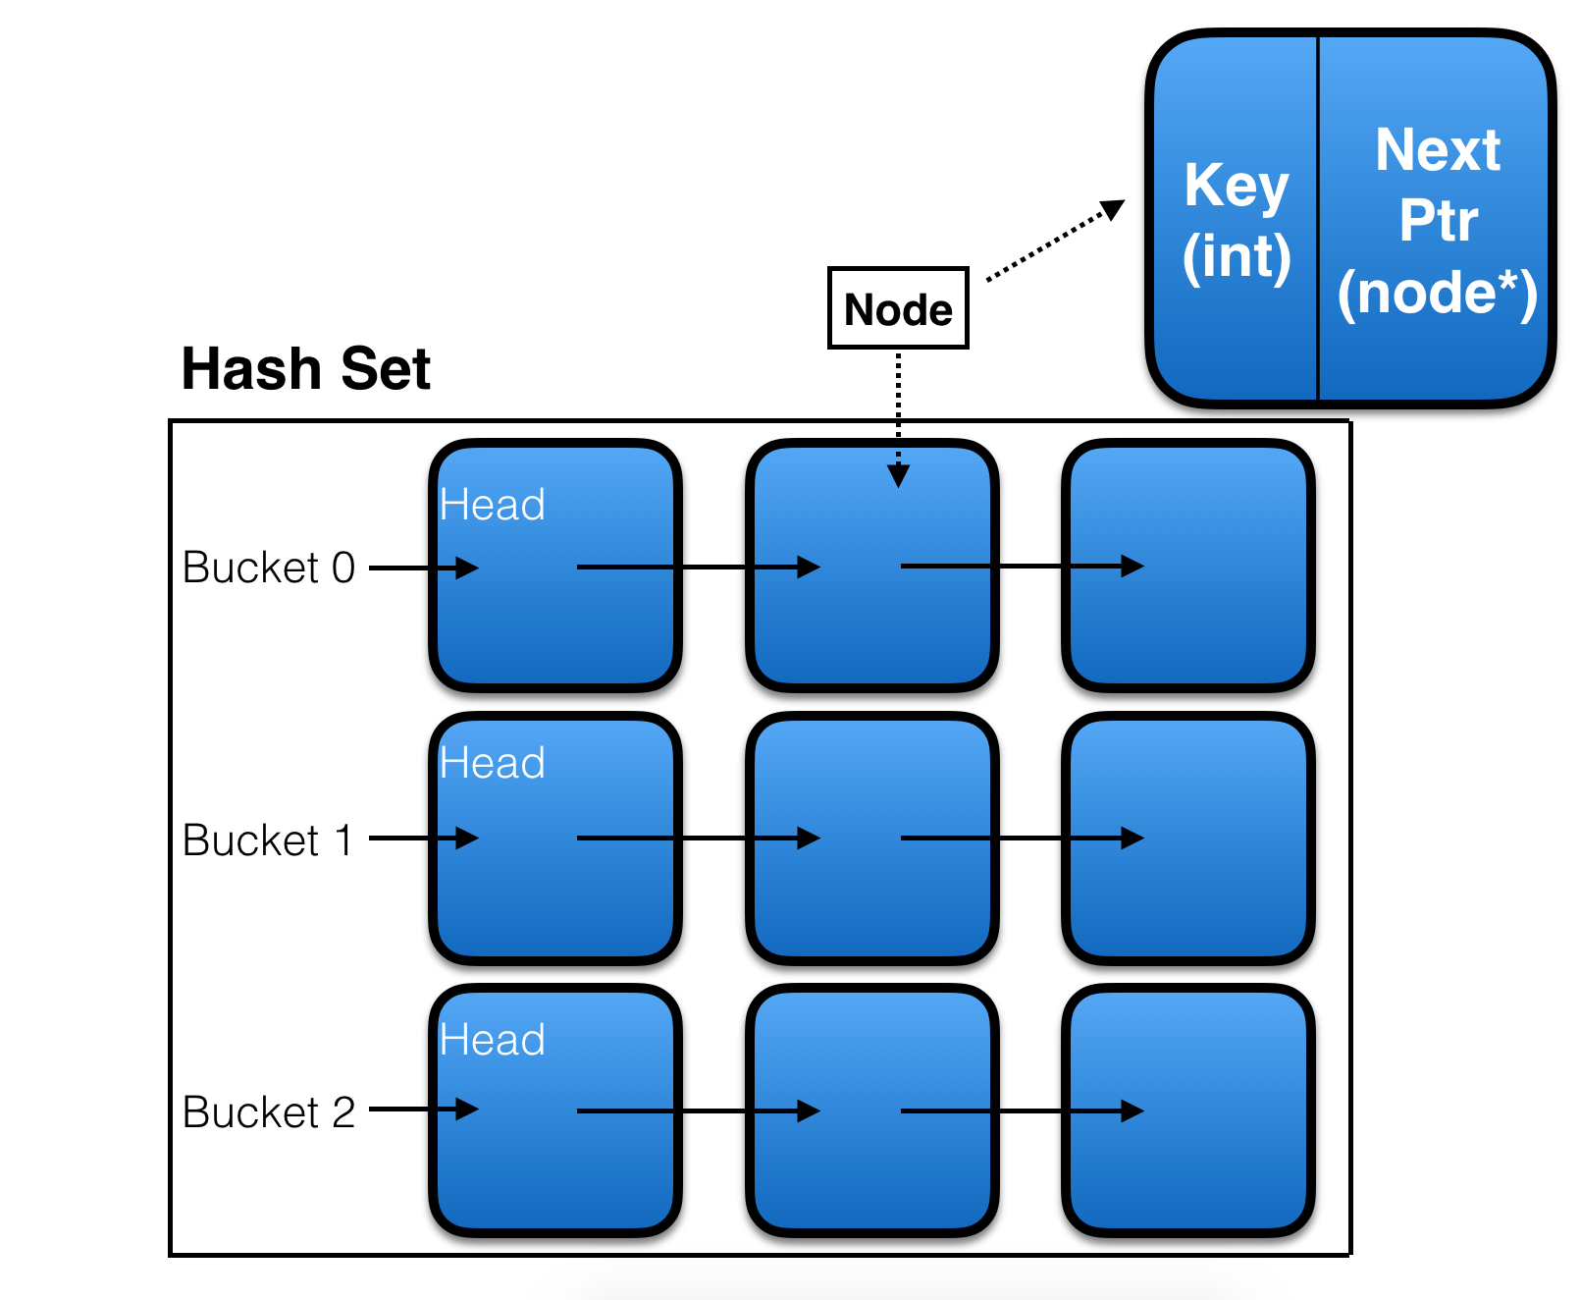
Hash Set Implementation
Array of Buckets.
Buckets are Linked Lists of Nodes.
Supported Functions:
Insert
Remove
Search

Slide 3

Why Parallel?
Multiple simultaneous operations.
E.g. Two threads inserting simultaneously.
When doing multiple operations simultaneously, we have to use locks, or another method, to avoid corrupting our data structures.

Slide 4
Hash Set Implementations
Locking
Coarse-Grained
Mid-Grained
Fine-Grained
Lock-Free
Harris (2001)
Binary Tree
(Bucket Lock)
(Node Lock)

Slide 5
Harris (2001)
M = Marked
5
6
11
14
15
22
Head
M
M
M
M
Marking is beneficial over its fine-grained locking counterpart because, unlike locks, the markers disappear on a context switch or thread swap, in order to not block other threads.

Slide 6
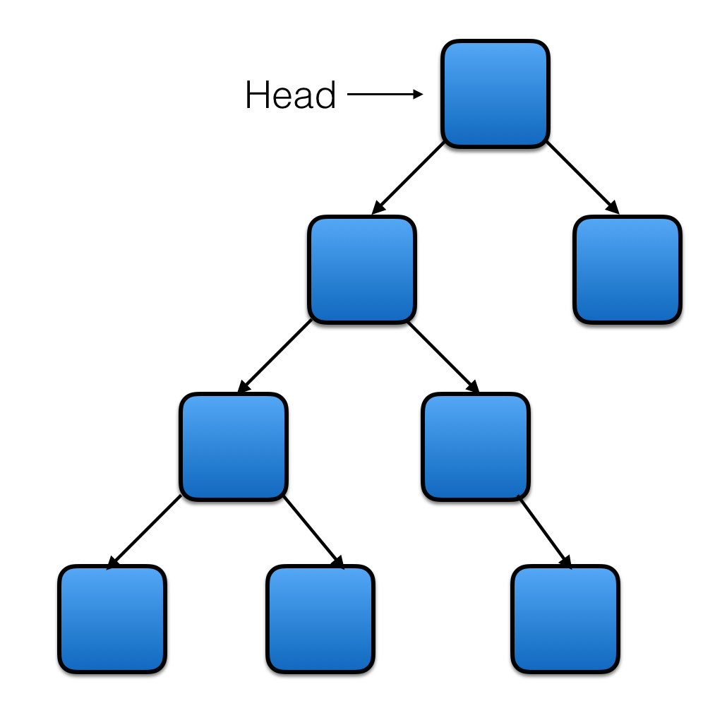
Binary Tree Implementation
Visit lg n Nodes

Slide 7
Binary Tree Implementation Challenges
12
Suppose we want to remove 4...
12
M
4
15
6
15
M
3
9
3
9
M
6
10
8
10
M
8
M

Slide 8
Experimental Setup
Testing was run on the CMU LateDays servers:
2 CPUs
6 Cores
Hyper-Threaded
Clocked at 2.4 GHz
We define Contention-like Metric: r = maximum # of inserts to a single bucket
We measure runtime as we increase r.

Slide 9
High Contention Results
Mid Grained (Locking)
Fine Grained (Locking)
Harris (Lock Free)
Runtime (s)
200
50
12.5
3
Binary Tree (Lock Free)
0.75
Contention-like metric r
100
1,000
10,000
100,000
1,000,000

